Slide 1

MCA Major Project End Term Evaluation
AI-Powered Content Generation & Speech Synthesis with RAG and TTS
Under the guidance of
Dr. Devershi Pallavi Bhatt
Department of Computer Applications
Faculty of Science, Technology and Architecture
Manipal University Jaipur
By
Jagriti
23FS20MCA00023
2023-25

Slide 2
Outline
Introduction
Motivation
Process Model
Software Requirement Specification (SRS)
End-to-End Pipeline
Output
Conclusion
Future Scope

Slide 3
Introduction
What is the project about?
In today’s world, videos are used everywhere—YouTube, Instagram, education, and even news. But editing videos is hard work and the old way takes a lot of time and effort. Creators have to:
Add voiceovers
Make subtitles
Cut scenes
Match voice with video
So, Clipo AI created Clipo.Pro, a smart platform that uses AI to make video editing faster and easier.
During my internship, I worked on improving this platform by adding: Speech recognition (using Whisper) to turn speech into text automatically. Text-to-speech systems (Kokoro-ONNX and Dia-1.6B) to create natural AI voices. Scene detection (using CLIP) to find scene changes and camera angle shifts. These tools help creators make better videos quickly and in many languages.

Slide 4
What is Clipo AI?
Clipo AI is an AI-powered video editing platform designed to help content creators and businesses edit, repurpose, and enhance videos quickly and efficiently. It uses artificial intelligence to automate tasks that usually take a lot of time, such as cutting videos, adding subtitles, and predicting which clips might go viral.
The goal of Clipo AI is to make video editing 10 times faster and reduce 90% of the manual effort required for content creation. This makes it a perfect tool for YouTubers, social media influencers, businesses, and anyone who creates video content regularly.
What Does Clipo AI Do?
Clipo AI offers several AI-powered tools to make video editing easier:
Automatic Video Clipping – The AI automatically picks the best parts of a video and creates short, engaging clips.
Subtitle & Caption Generation – Uses advanced speech recognition to generate accurate subtitles for videos.
Virality Score Prediction – Analyzes a video and predicts how likely it is to go viral before you even publish it.
GIF & B-Roll Generation – Creates short animations (GIFs) and background footage (B-roll) to make videos more interesting.
Emoji Prediction & Platform-Specific Captions – Suggests the best emojis and captions to boost audience engagement.
These features help creators focus on content creation instead of spending hours on editing.

Slide 5
Company Mission
Clipo AI’s mission is to make video editing easy and accessible for everyone by using artificial intelligence. Instead of struggling with complex editing software, creators can let AI handle the time-consuming parts while they focus on storytelling and creativity. They want to help businesses, influencers, marketers, and everyday creators produce high-quality content faster than ever before.
Contact details, visit: www.clipo.pro Contact: contact@clipo.pro
Address
Regd. Address: B32/48 K-2-A-11 3RD FLOOR, KUBER HOUSE, SAKET NAGAR, Durgakund, Varanasi- 221005, Uttar Pradesh CIN: U62099UP2024PTC200261
Email: contact@clipo.pro | mobile: 9935666589
Reporting Manager: Abhishek Rai

Slide 6
Motivation
Video creation is booming—used widely in education, marketing, and entertainment.
But editing is hard: adding voiceovers, subtitles, and cutting scenes takes time and skill.
Most tools today are slow, manual, and not AI-powered.
There’s a big need for smart, automated tools that can:
Understand video scenes
Convert speech to text (ASR)
Generate natural voices (TTS)
Work across languages and styles
My internship at Clipo AI aimed to solve this by building an AI-based video editing pipeline.
This helps creators save time, make better videos faster, and reach more audiences through automation.

Slide 7
Process Model
Steps followed in this project:
Audio Input Module
Takes any audio/video and prepares it (removes noise, silence, etc.)
Speech Recognition (ASR)
Converts voice to text using Whisper model by OpenAI
Scene Detection
Finds where scenes change or speakers change using TransNet V2 and CLIP
Text Improvement (RAG)
Adds extra context to the text (like a chatbot) to improve narration
Text-to-Speech (TTS)
Converts text back to voice using Kokoro and Dia-1.6B models
Final Output
Merges everything and creates a video with realistic AI voice and accurate subtitles

Slide 8
Software Requirement Specification
Hardware Used:
Ryzen 9 CPU, 32 GB RAM, GPU for training models
Software & Tools:
Python 3.10
Whisper ASR (by OpenAI)
Dia 1.6B (TTS from HuggingFace)
Kokoro ONNX (for fast voice synthesis)
Librosa, MoviePy, OpenCV (audio/video editing)
FFmpeg, HuggingFace Transformers

Slide 9
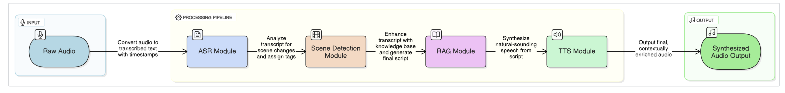
End-to-End Pipeline
1. Raw Audio (Input)
User provides audio input (e.g., podcast, voiceover).
2. ASR Module
Converts the speech into text with timestamps using Whisper.
3. Scene Detection Module
Analyzes the transcript to find scene changes or topic shifts using TransNet V2 + CLIP.
4. RAG Module
Enhances the transcript by adding external context or summaries using Retrieval-Augmented Generation.
5. TTS Module
Generates natural, human-like voice from the final script using Kokoro-ONNX or Dia-1.6B.
6. Synthesized Audio Output (Final Output)
The final result is enriched, context-aware speech ready to be used in videos or podcasts.

Slide 10
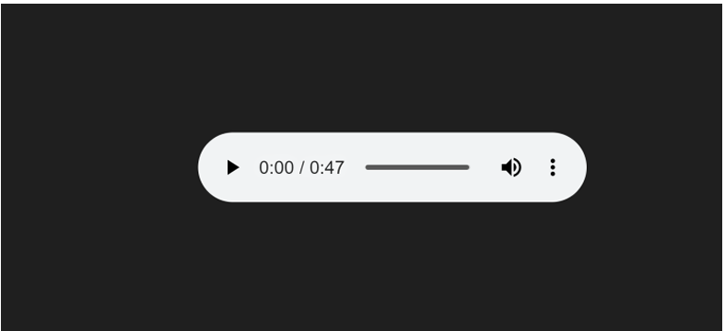
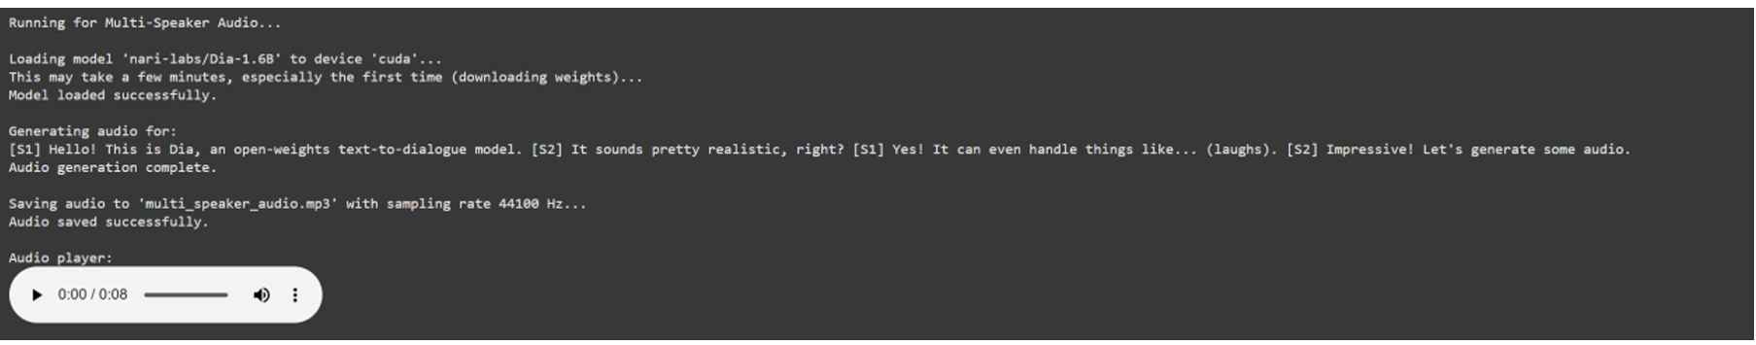
Outputs / Screenshots
Here are the results from the project:
Waveform Output – shows smooth and clear voice
Dia TTS Output – gives emotional and human-like speech.

Slide 11
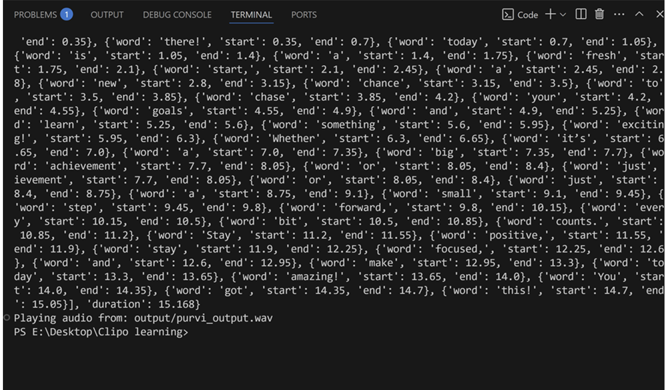
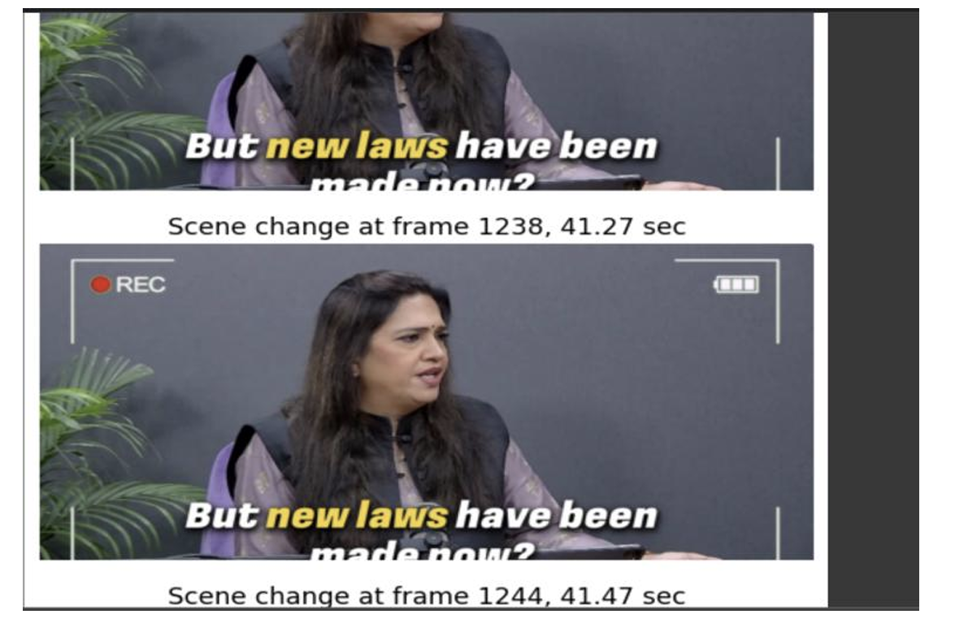
Outputs / Screenshots
Here are the results from the project:
Timestamps – text is properly aligned with audio.
Scene Detection – splits video based on topic or speaker change.

Slide 12
Conclusion
This project built an AI-powered multimedia pipeline to automate key parts of video and audio editing.
It integrated state-of-the-art models for:
ASR (OpenAI Whisper) – to convert speech to text.
TTS (Kokoro-ONNX & Dia-1.6B) – to generate natural, multilingual voices.
Scene Detection (CLIP) – to understand and segment video scenes.
RAG – to enhance transcript content with contextual intelligence.
The pipeline helps content creators:
Save editing time
Improve content quality
Support multiple languages
Make videos more accessible
I gained hands-on experience in deploying AI models, optimizing performance, and working in a real-world product environment at Clipo AI.
This project shows how AI can transform digital storytelling—making content creation faster, smarter, and more creative.

Slide 13
Future Scope
1. Phoneme-Level Alignment for Better Sync
Use tools like Montreal Forced Aligner to improve lip-sync and subtitle accuracy.
2. Real-Time Streaming Support
Optimize TTS and ASR for live applications like virtual assistants, chatbots, and avatars.
3. Voice Emotion & Style Control
Add features to control emotion, pitch, speed, and tone for more personalized speech.
4. Multilingual & Code-Switching Capabilities
Expand support to Indian languages, Hinglish, and mixed-language scripts.
5. User-Friendly GUI Development
Build a drag-and-drop web interface for non-technical users using tools like Streamlit or Flask.
6. Mobile & Edge Deployment
Use model quantization and ONNX optimization to run the pipeline on mobile or low-resource devices.
7. Advanced Scene Understanding
Integrate face detection, speaker ID, and gesture recognition for better visual context.
8. Smarter Retrieval-Augmented Generation
Improve the RAG module with dynamic prompt engineering and domain-specific memory.

